Slide 1

Mikael Hakansson
Integration MVP
IoT – Common patterns and practices
Notes:
Setup:
Stop Function
Clear PBI

Slide 2
IoT === integration
Notes:
Microsoft Azure IoT Hub provides capabilities for securely connecting, provisioning, updating and sending commands to devices. IoT Hub enables companies to control millions of IoT assets running on a broad set of operating systems and protocols to jumpstart their Internet of Things projects.
IoT Hub enables companies to:
Establish reliable bi-directional communication with IoT assets, even if they are intermittently connected, so companies can analyze incoming telemetry data and send commands and notifications as needed.
Enhance security of IoT solutions by leveraging per-device authentication to communicate with devices with the appropriate credentials.
Revoke access rights to specific devices, if needed, to maintain the integrity of the system.

Slide 3
Introducing Microsoft Azure IoT Hub
IoT Hub is available as a stand-alone service or as one of the services used in the new Azure IoT Suite
Azure IoT Hub is designed to connect your devices to Azure.
Millions of simultaneously connected devices
Per-device authentication
High throughput data ingestion
A variety of communication patterns
Reliable command and control
Notes:
Microsoft Azure IoT Hub provides capabilities for securely connecting, provisioning, updating and sending commands to devices. IoT Hub enables companies to control millions of IoT assets running on a broad set of operating systems and protocols to jumpstart their Internet of Things projects.
IoT Hub enables companies to:
Establish reliable bi-directional communication with IoT assets, even if they are intermittently connected, so companies can analyze incoming telemetry data and send commands and notifications as needed.
Enhance security of IoT solutions by leveraging per-device authentication to communicate with devices with the appropriate credentials.
Revoke access rights to specific devices, if needed, to maintain the integrity of the system.

Slide 4





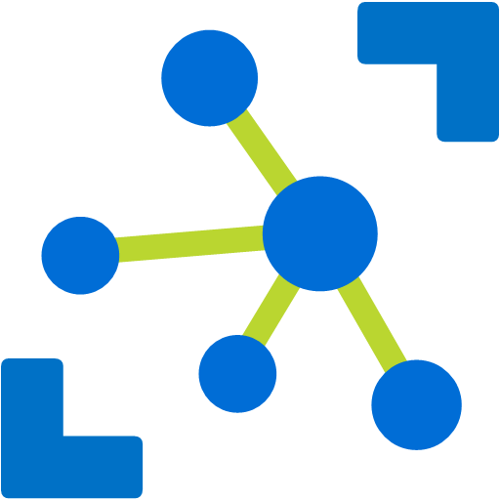



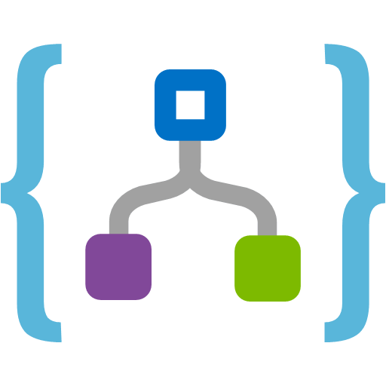

Azure IoT Solution Architecture
IoT Hub
Cold path persisting
IP-capable
Cloud protocol
gateway
Field gateway
Hot path analytics
1
1
0
1
1
0
0
1
0
0
0
1
1
0
1
0
1
0
1
0
0
1
1
0
0
1
1
0
1
0
0
1
1
1
None IP-devices
Hot path business application integration
field
cloud
Notes:
Connecting your devices is the 1st challenge that you have when creating an IoT solution. There is a vast variety of devices you may want to connect. Some are internet capable and in that case you can connect them directly to Azure service (eg: IoT Hub) or you can use your own Cloud protocol gateway in case the device you are trying to connect does not have a protocol supported by IoT Hub (at this time AMQP or HTP). However, some devices are not internet capable and those devices need a field gateway to connect to the cloud. This gateway can do many things – not only connectivity and protocol translation but on the application back end side, one of the most important use cases is telemetry. You usually want to have an event processing and insight pipeline and IoT Hub will allow you to get a feed from the devices and events easily.
The 2nd big component that IoT solutions have with cloud is device big logic that takes care of interactive scenarios of your solutions – think about opening your car door or adjusting your home thermostat from your smart phone or sending a command to a device to update a piece of firmware.
Finally IoT Hub has to know which devices have to connect and which devices are present for IoT solution. For this purpose it has to interact with the visioning and management component which is the component that makes sure that the devices are on-boarded and de-provisioned correctly from your own IoT solutions.

Slide 5
Communication Scenarios
Telemetry
Inquiries
Commands
Notifications
Information flowing from a device to other systems for conveying status of device and environment
Requests from devices looking to gather required information or to initiate activities
Commands from other systems to a device or a group of devices to perform specific activities
Information flowing from other systems to a device (group) for conveying status changes

Slide 6



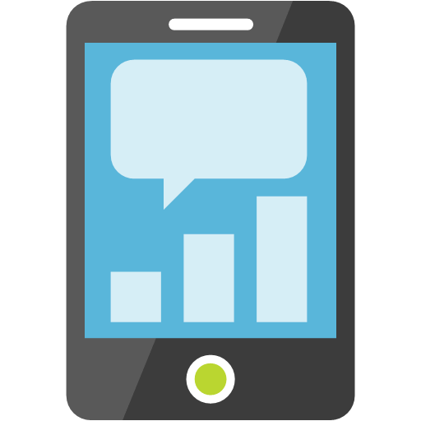

Inside the IoT Hub
Events
Devices
IoT Hub
Machine Learning
Cosmo DB
Stream Analytics
Messaging
Function App
Logic App
Custom

Slide 7
Inside the IoT Hub
State
Devices
IoT Hub
Function App
Twin
Tags
Desired
Logic App
Reported
Custom

Slide 8
Information Exchange Patterns Basics of IoT Communication
Events
Messaging
Methods
State
Massive stream of information. Managed outside the IoT Hub
C2D communication using a pub/sub pattern using topics & subscriptions
Devices exposes methods that can called from a external applications using a request/response pattern
Device state is exchanged using device-twin configuration stored in the IoT Hub.

Slide 9
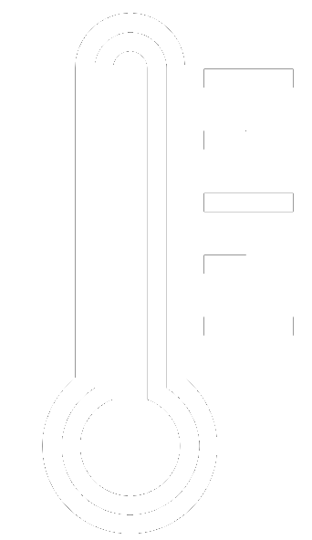
A sample scenario - Demo #1
Simulated thermometer
Emits telemetry every second
Stream Analytics
A Stream Analytics Job receives the readings and forward all readings to Power BI and Service Bus
IoT Hub
Event Processor
Stream Analytics
Power BI
Notes:
The sample scenario used in the demo.
A console simulator represent an individual wind turbine, emitting telemetry every second.
Also it simulates wind turbine start ad stop lifecycle, controlled by the cloud.
The main portions of the demo are:
provisioning: a simple portal app provisions devices with a device registry (implemented in a DocDB in the demo) and the hub identity registry.
The previous step enables a device simulator to connect to the hub and start emitting telemetry and listen for commands.
Telemetry is received by a console app running an Event Processor Host, which updates the portal with the latest telemetry values.
From the portal we can then send commands, which are recorded in a command store (to keep track of the status of each command).
The simulators reacts to the commands and send responses back through the D2C stream. The event processor then can distinguish command responses from telemetry messages and update the command store accordingly.

Slide 10
A sample scenario – Demo #2
Simulated thermometer
Emits telemetry every second
Stream Analytics
A Stream Analytics Job receives the readings and forward all readings to Power BI and Service Bus
Function App
An Azure function receives readings from queue and notifies device
IoT Hub
Event Processor
Stream Analytics
Power BI
Message Processor
SB Queue
Function App
Notes:
The sample scenario used in the demo.
A console simulator represent an individual wind turbine, emitting telemetry every second.
Also it simulates wind turbine start ad stop lifecycle, controlled by the cloud.
The main portions of the demo are:
provisioning: a simple portal app provisions devices with a device registry (implemented in a DocDB in the demo) and the hub identity registry.
The previous step enables a device simulator to connect to the hub and start emitting telemetry and listen for commands.
Telemetry is received by a console app running an Event Processor Host, which updates the portal with the latest telemetry values.
From the portal we can then send commands, which are recorded in a command store (to keep track of the status of each command).
The simulators reacts to the commands and send responses back through the D2C stream. The event processor then can distinguish command responses from telemetry messages and update the command store accordingly.

Slide 11


A sample scenario – Demo #3
Simulated thermometer
Emits telemetry every second
Stream Analytics
A Stream Analytics Job receives the readings and forward all readings to Power BI and Service Bus
Function App
An Azure function receives readings from queue and notifies device
Simulated thermostat
Controls the heating of the room
Device State
Device receives update Desired State and adjust thermostat
IoT Hub
Event Processor
Stream Analytics
Power BI
Message Processor
SB Queue
Function App
Manage State
Notes:
The sample scenario used in the demo.
A console simulator represent an individual wind turbine, emitting telemetry every second.
Also it simulates wind turbine start ad stop lifecycle, controlled by the cloud.
The main portions of the demo are:
provisioning: a simple portal app provisions devices with a device registry (implemented in a DocDB in the demo) and the hub identity registry.
The previous step enables a device simulator to connect to the hub and start emitting telemetry and listen for commands.
Telemetry is received by a console app running an Event Processor Host, which updates the portal with the latest telemetry values.
From the portal we can then send commands, which are recorded in a command store (to keep track of the status of each command).
The simulators reacts to the commands and send responses back through the D2C stream. The event processor then can distinguish command responses from telemetry messages and update the command store accordingly.

Slide 12

A sample scenario – Demo #4
Simulated thermometer
Emits telemetry every second
Stream Analytics
A Stream Analytics Job receives the readings and forward all readings to Power BI and Service Bus
Function App
An Azure function receives readings from queue and notifies device
Device Method
Use device methods to call a method declared on the device
IoT Hub
Event Processor
Stream Analytics
Power BI
Message Processor
Custom App
SB Queue
Function App
Manage State
Notes:
The sample scenario used in the demo.
A console simulator represent an individual wind turbine, emitting telemetry every second.
Also it simulates wind turbine start ad stop lifecycle, controlled by the cloud.
The main portions of the demo are:
provisioning: a simple portal app provisions devices with a device registry (implemented in a DocDB in the demo) and the hub identity registry.
The previous step enables a device simulator to connect to the hub and start emitting telemetry and listen for commands.
Telemetry is received by a console app running an Event Processor Host, which updates the portal with the latest telemetry values.
From the portal we can then send commands, which are recorded in a command store (to keep track of the status of each command).
The simulators reacts to the commands and send responses back through the D2C stream. The event processor then can distinguish command responses from telemetry messages and update the command store accordingly.

Slide 13
Transport protocol – Functional comparison
AMQP / AMQP-WS
Support Complete, Reject and Abort on receiving messages.
Supports Exactly once delivery
Support message Meta data
MQTT / MQTT-WS
Supports Device State
Supports Device Methods
Supports QoS 0 & 1 (”at most once” and ”at least once”)
Drops connection on error
http://vasters.com/blog/From-MQTT-to-AMQP-and-back/

Slide 14
Q&A
(first question gets a CR7 shirt for free)

Slide 15
Thank you

